Slide 1
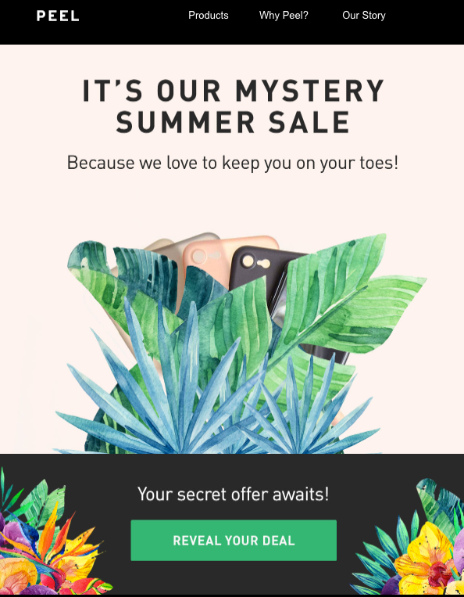
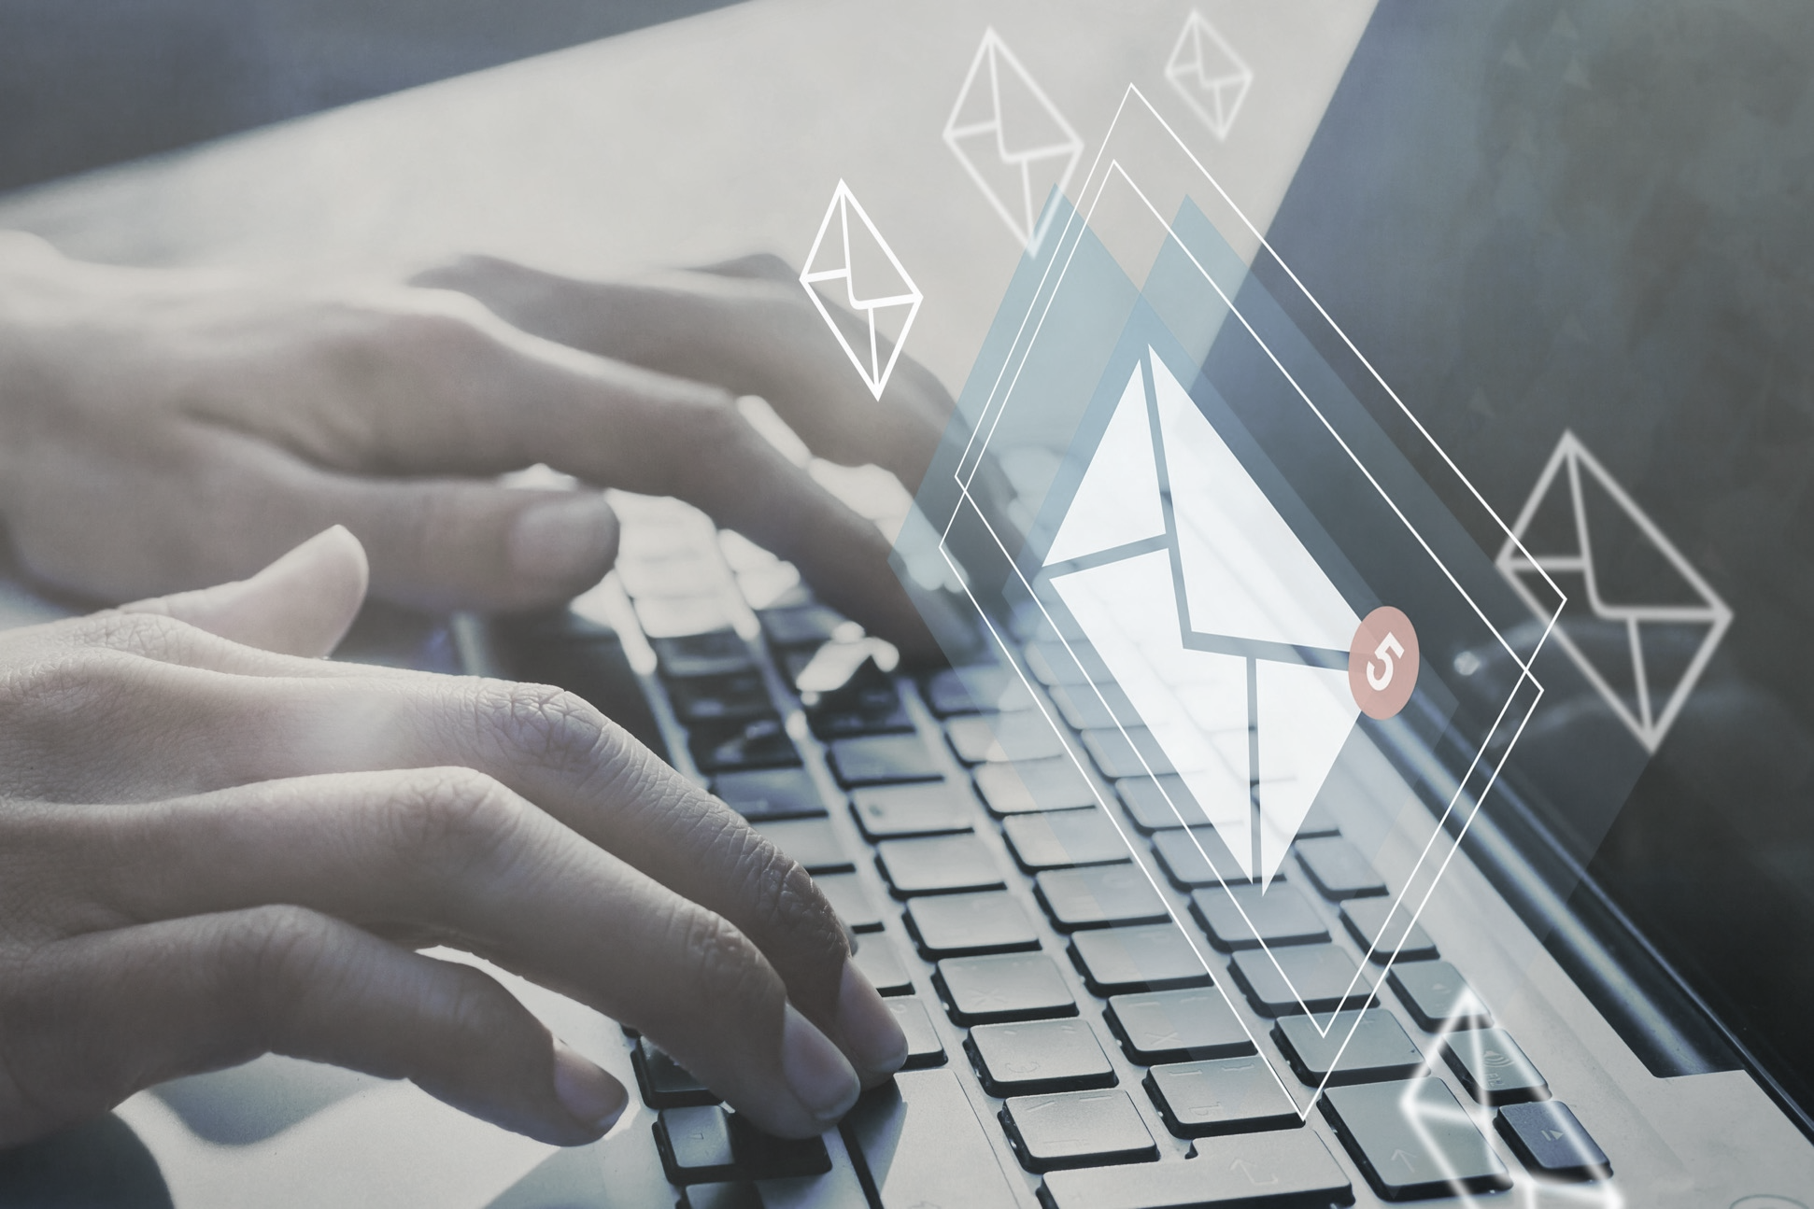
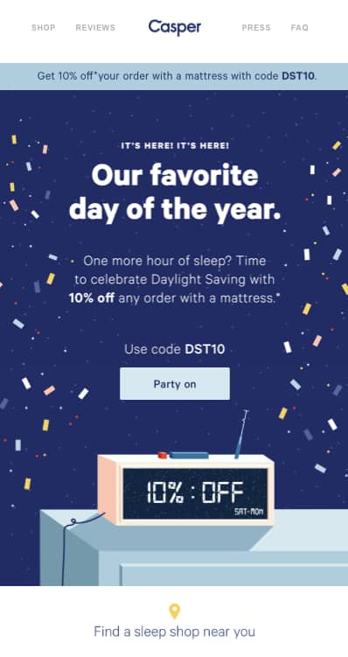

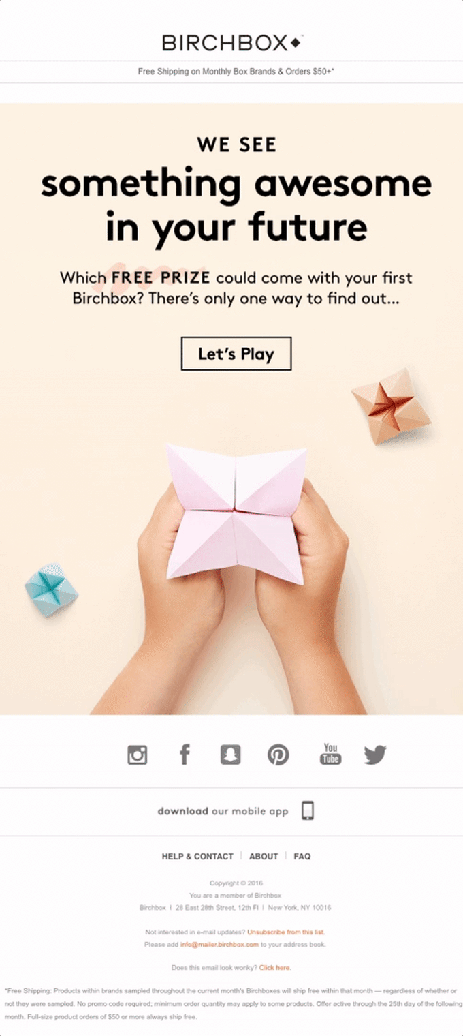
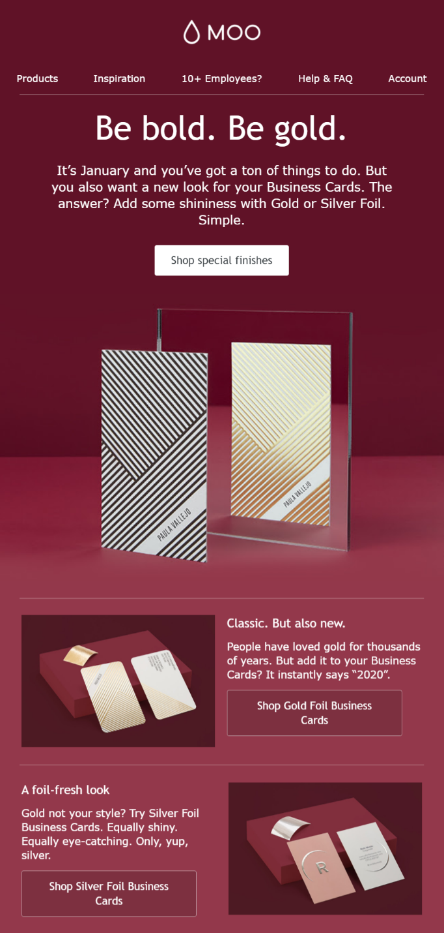


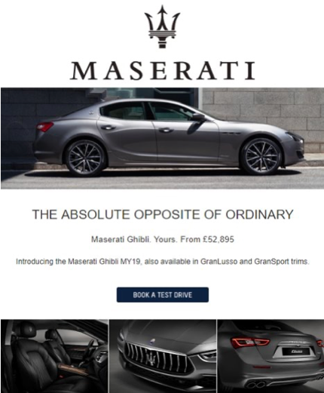
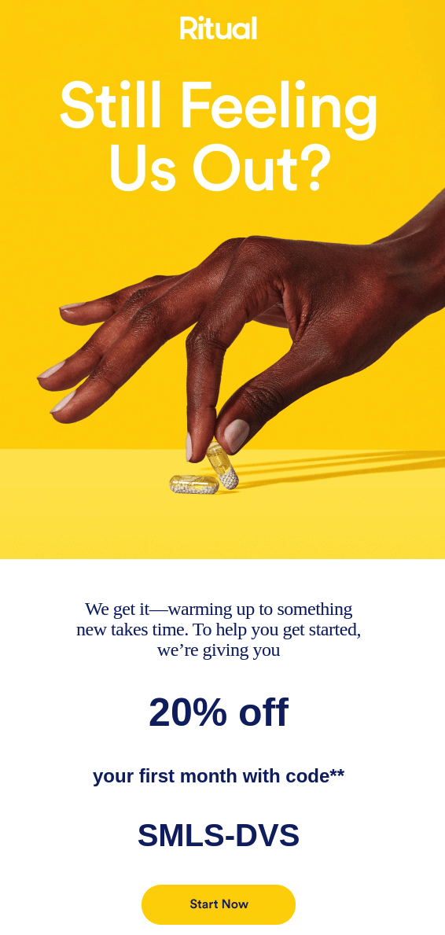

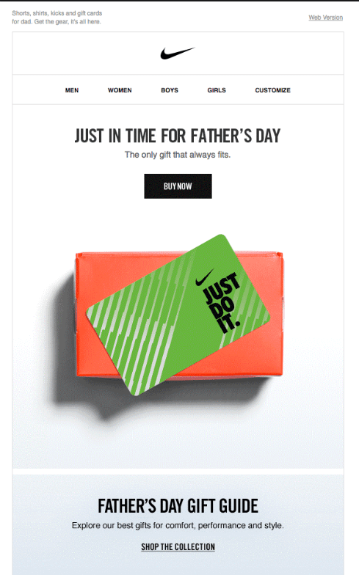
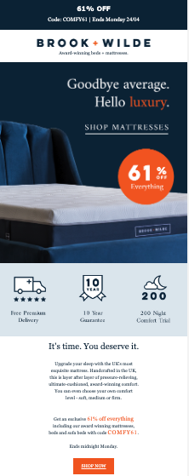
Creative Requirements & Best Practice

Slide 2





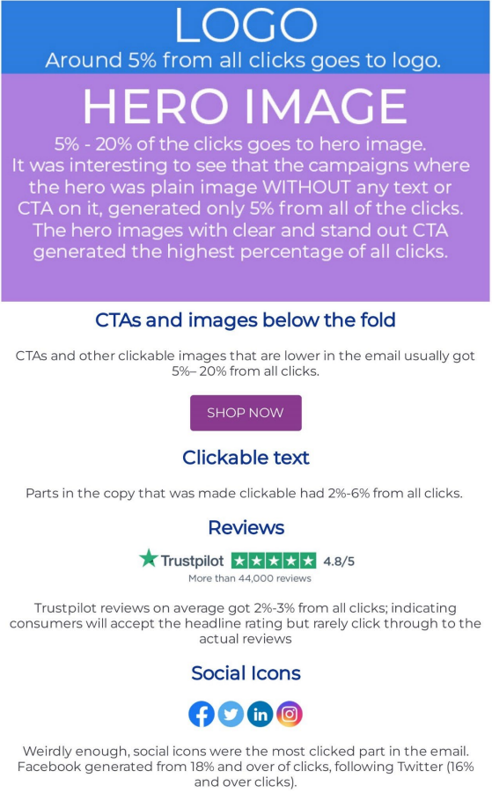

Leverage inbox data to improve omnichannel targeting & ROI
Actions
Behaviours
Send, open & click from emails
Real time interests & intent from the inbox
Demographics
Modelled
Age, gender, HHI, geo, family & more
Predictions on wealth, car + home ownership & more...
Email Creative Best Practice
Clear headline above the fold (first 300ish pixels) with the key benefit
Button above the fold, which contrasts with the image and looks like a button
Button on every page scroll
Text is easy to scan, use of bullets points and avoid long paragraphs
Use icons to illustrate key points e.g. 0% finance, free delivery etc.
50:50 images to text but images always perform
Use roundels on images to highlight additional offers
600 pixel wide
Single column
Use known brands/partnerships near the top of the creative to provide validation for your brand e.g. Seen in X, Y, Z or Stocked in X, Y, z, worn by X, Y, Z, or brands stocked include X, Y, Z or compare offers from X, Y, z
Font needs to be an email friendly font on text (fine to use any fonts on images). If you want to use your font, always ensure there is a fallback font you are happy with.
Background images will be stripped out on outlook – avoid using them

Slide 3
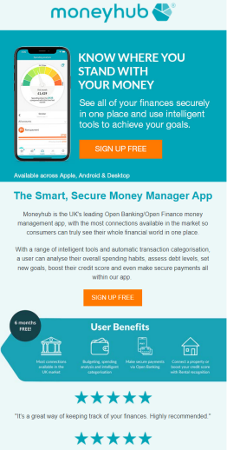
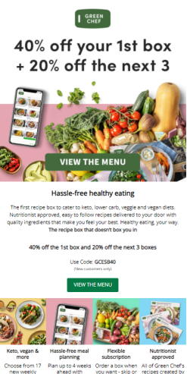
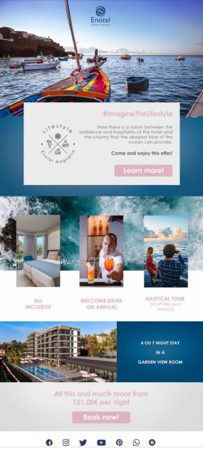
Icons work very well to
demonstrate key benefits
Clear headline/incentive at
top of email and button with
CTA above the fold
Plenty of nice imagery but
with a balance of text

Slide 4
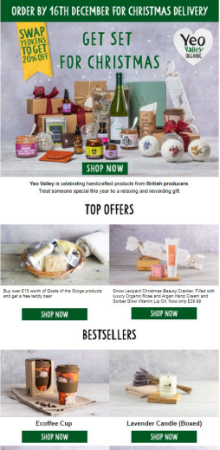
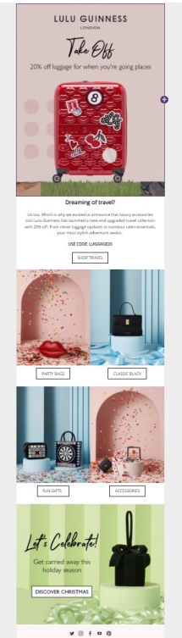
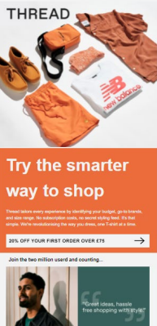
Visual way to show categories
and easy to navigate
Lots of CTA’s, good use of
colours.
Clear headline, subtle use of
other brands to drive
familiarity & social validation.

Slide 5
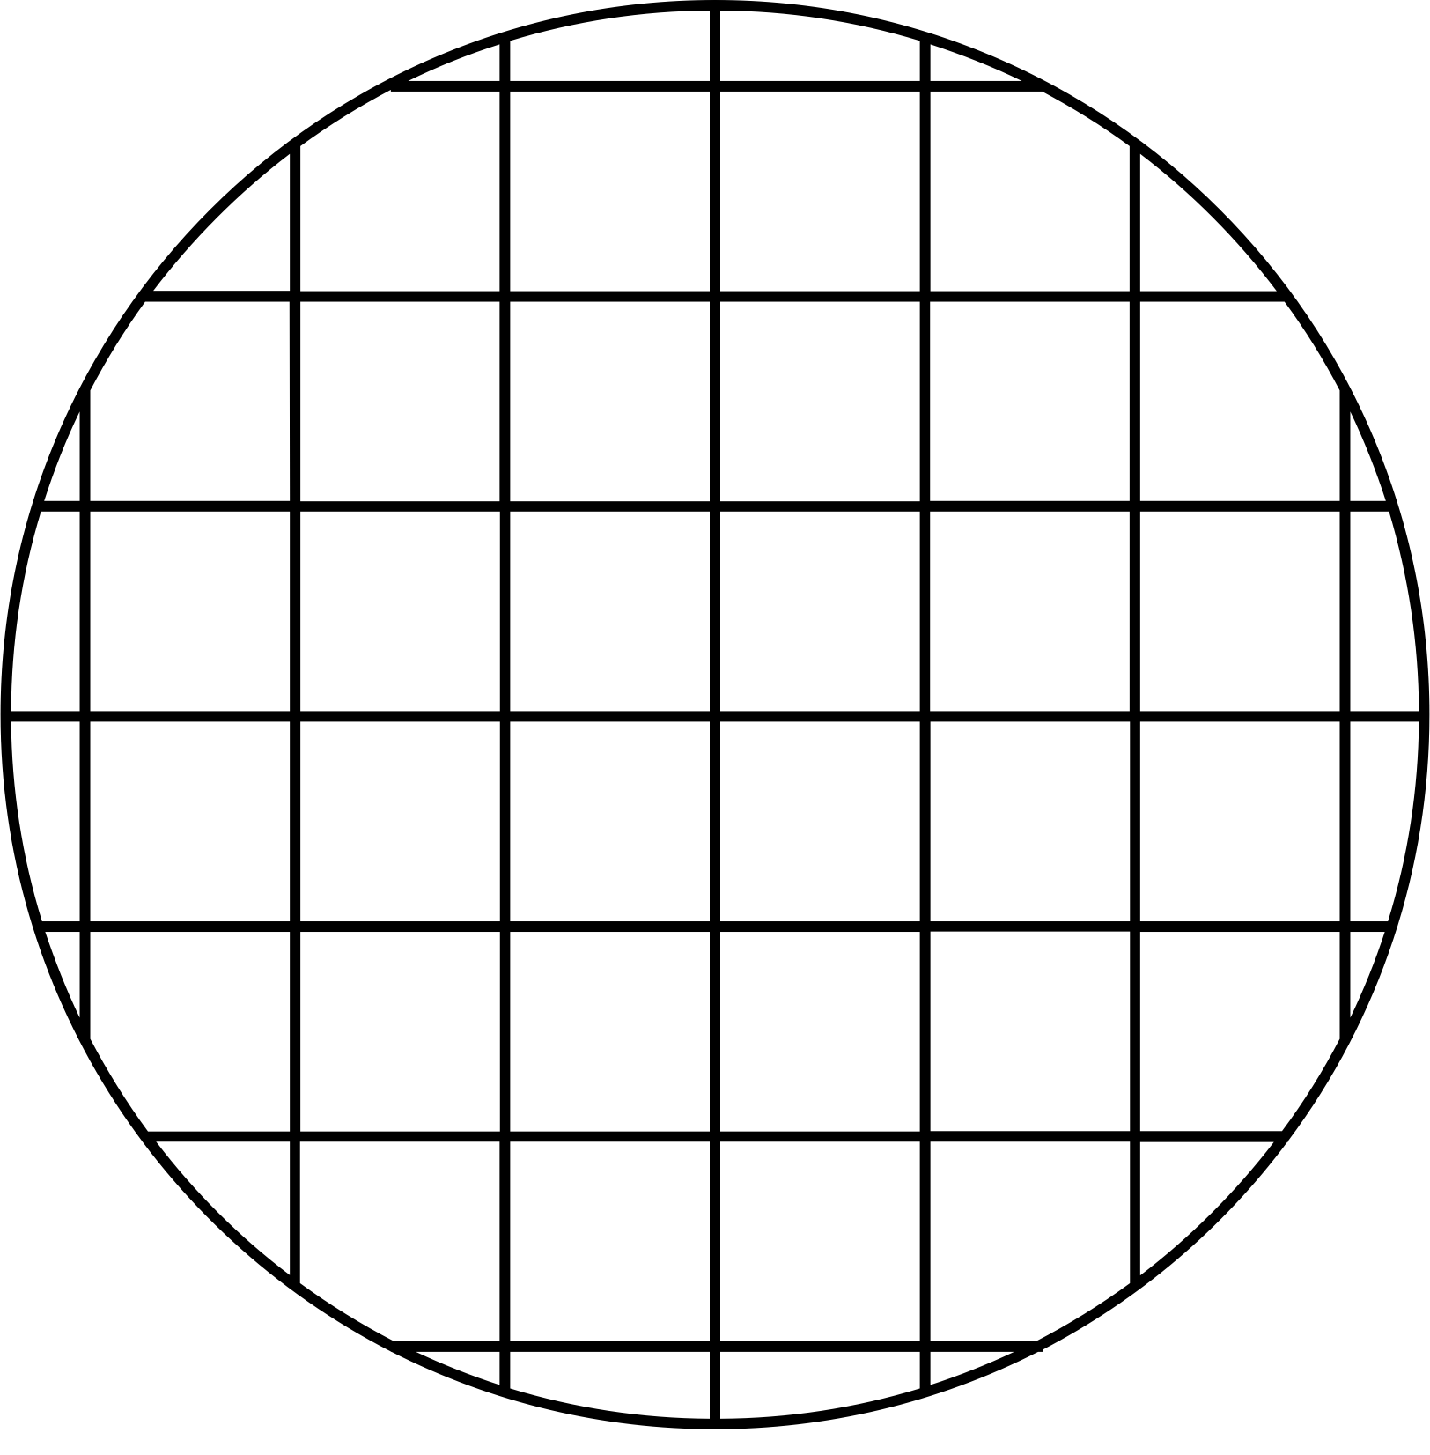
END
Final thoughts
• Background images are mostly stripped out in Outlook, so avoid them where possible. If you have a patterned background, choose a solid colour to replace it with, if background images don’t display
• Always have text – view your email without images on and see what is visible. Never
just use images
• Add alt text – in case images are off
• Clear design
• Make it timely
• Why is this email useful to the consumer – consider this & make this clear in the
content
• Make it visual, easy to scan but remember to consider what it looks like
with images switched off
Any questions?
Connect with us at hello@esbconnect.com

